Slide 1
Example of a template that could be used when presenting at a FELLOWSHIP NIGHT developed by R.W. Tim Martel, Chairman of the MEALS Committee

Slide 2
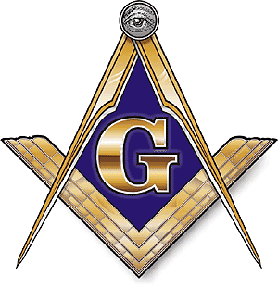
FELLOWSHIP NIGHT

Slide 3
Introduce Yourself
Where did you grow up
What is your vocation
Tell them a little about your family
What brought you to Masonry
What does Masonry mean to you and your family

Slide 4
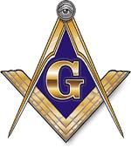
Freemasonry
Freemasonry/Masonry is the oldest and largest fraternity in the world
Nobody knows exactly how old it is
Earliest known document associated with Masonry is the REGIUS Poem, written in 1390.
Freemasons are dedicated to serving God, Mankind and their Country.
All Masons believe in God the Creator, and they respect all religions.

Slide 5
Three million Masons in North America alone. (Approximately 20,000 in Maine)
Dedicated to serving God, Family, Mankind and Country
Masons donate $3 million daily to various charities
Shrine Children’s Hospitals
Scottish Rite Learning Centers for dyslexic children
Knights Templar Eye Foundation which provides assistance to
facing loss of eye sight
Various college scholarships
Child Identification Program (CHIPS)
Community projects too numerous to mention

Slide 6
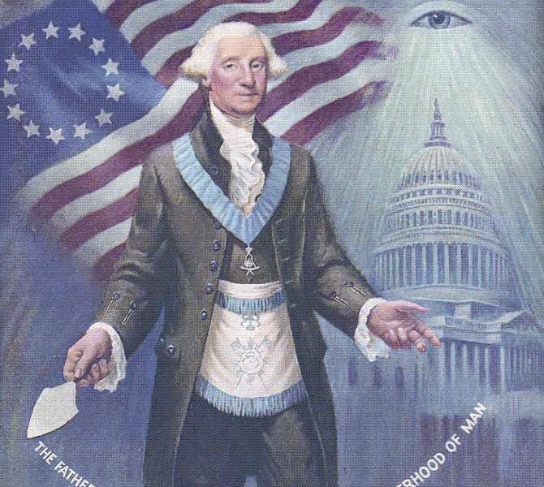
Where Did Masonry come From?
England by our Founding Fathers, and many, such as George Washington, Ben Franklin and Paul Revere were active Masons.
Some other famous Masons:
Douglas MacArthur
John Paul Jones
Charles Lindbergh
Franklin D. Roosevelt
Theodore Roosevelt
John Wayne
John Phillip Sousa
Buzz Aldrin
Henry Ford
Gerald Ford
Rudyard Kipling
Ty Cobb
Sam Houston
Harry S. Truman
Howard Taft

Slide 7
Two Favorite Theories on Origins
Theory #1
Began in Europe with building of cathedrals in countries bordering Mediterranean Sea
Highly skilled operative Masons, sought by Kings, Princes, Potentates
These men were FREE (not indentured) & could travel anywhere
Young boys served as Entered Apprentices for Master Masons
After several years of experience they could become Fellows of the Craft
After many years, they could become Master Masons

Slide 8
Theory #2
Freemasonry was created by the Knights Templar.
The original Knights Templar (1099) consisted of nine citizen monks whose mission was to protect Christians traveling to and from the Holy Land.
They were extremely brave and their reputation as skilled warriors was second to none.
Some believe that these nine citizen monks were also commissioned to dig for & to protect Holy artifacts beneath the ruins in Jerusalem.

Slide 9
Theory #2 (Cont.)
Over time the number of Knights Templar grew extensively and the fraternal order became rich and powerful, even though the individual Knights had pledged to live in poverty and chastity.
Papacy located in France & Muslims controlled Holy City
Friday 13, 1307 King Phillip (The Fair) of France manipulated Pope Clement V to take the assets of the Knight Templar order by capturing their grand master, Jacques DeMolay, and 5,000 unsuspecting Knights.
They were imprisoned and tortured until they confessed to crimes that they did not commit such as heresy, blasphemy, etc. Their assets were confiscated and many of the Knights including Jacques DeMolay were burned alive at the stake.
DeMolay suffered for 7 years and he was burned alive March 18, 1314.

Slide 10
What do Masons Believe?
Every person is responsible and accountable for his own life and actions.
Every person should learn and practice self control and that nobody has the right to tell another person what to think or believe.
Faith in God should be the center of a Mason’s life, but Masons worship in church, not in the lodge.
Every Mason is encouraged to be a good citizen, to try to make the world a better place for all.
Honor and integrity are essential to life.

Slide 11
What do Masonic Lodges do?
Teach moral lessons using the builders tools & allegories
Open and close every meeting with a prayer
Open every meeting with Pledge of Allegiance
Three degrees
Entered Apprentice (Youth)
Fellowcraft (Manhood)
Master Mason (Age)
Masonic lessons help all Masons to become better Husbands, Fathers, Sons, Brothers and citizens.

Slide 12
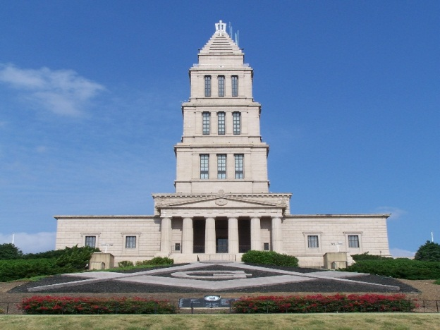
Questions?

